Slide 1
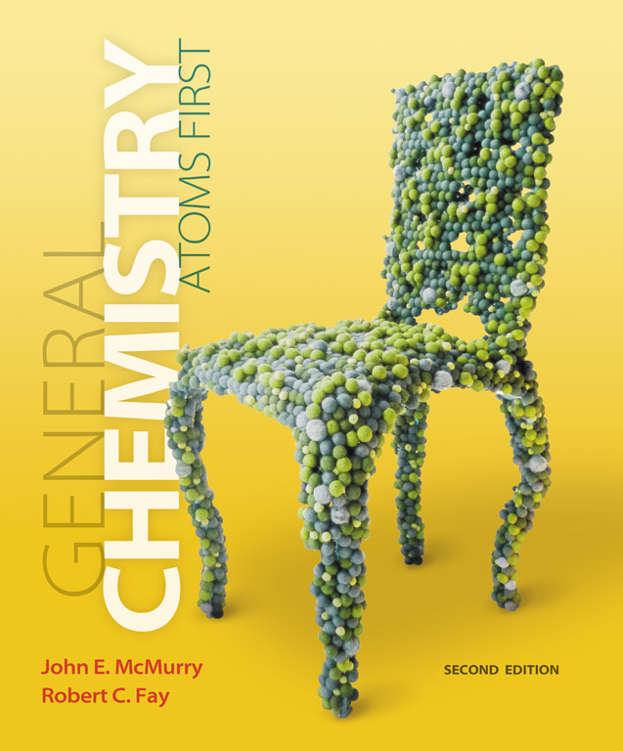
Clicker Questions
Chapter 6
Chemical
Arithmetic: Stoichiometry
Donald Linn
Indiana University–
Purdue University Fort Wayne
Fort Wayne, IN
© 2014 Pearson Education, Inc.

Slide 2
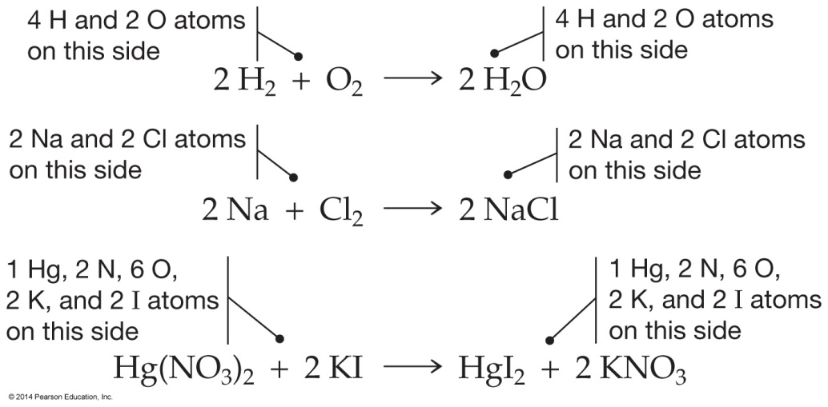
Which of the following reactions is improperly balanced?
a)
b)
c)
d)
e)
© 2014 Pearson Education, Inc.
Notes:
Answer: b

Slide 3
Which of the following reactions is improperly balanced?
a)
b)
c)
d)
e)
© 2014 Pearson Education, Inc.
Notes:
Answer: b

Slide 4
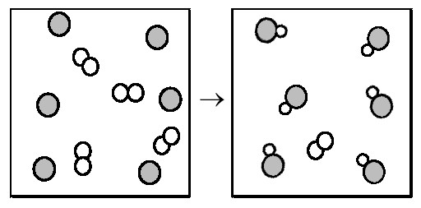
The following diagram represents the reaction of A₂ (unshaded spheres) with B (shaded spheres).
What is the balanced chemical equation for this reaction, and what is the limiting reactant?
a) A₂ + 2B → 2AB; A₂ is the limiting reactant.
b) A₂ + 2B → 2AB; B is the limiting reactant.
c) 4A₂ + 6B → 6AB; A₂ is the limiting reactant.
d) 4A₂ + 6B → 6AB; B is the limiting reactant.
e) None of the above
© 2014 Pearson Education, Inc.
Notes:
Answer: b

Slide 5
The following diagram represents the reaction of A₂ (unshaded spheres) with B (shaded spheres).
What is the balanced chemical equation for this reaction, and what is the limiting reactant?
a) A₂ + 2B → 2AB; A₂ is the limiting reactant.
b) A₂ + 2B → 2AB; B is the limiting reactant.
c) 4A₂ + 6B → 6AB; A₂ is the limiting reactant.
d) 4A₂ + 6B → 6AB; B is the limiting reactant.
e) None of the above
© 2014 Pearson Education, Inc.
Notes:
Answer: b

Slide 6
The following diagram represents the reaction of A₂ (unshaded spheres) with B (shaded spheres). How many moles of product can be produced from the reaction of 1.0 mol of A₂ and 1.0 mol of B?
a) 0.5 mol of product
b) 1.0 mol of product
c) 3.0 mol of product
d) 6.0 mol of product
e) None of the above
© 2014 Pearson Education, Inc.
Notes:
Answer: b

Slide 7
The following diagram represents the reaction of A₂ (unshaded spheres) with B (shaded spheres). How many moles of product can be produced from the reaction of 1.0 mol of A₂ and 1.0 mol of B?
a) 0.5 mol of product
b) 1.0 mol of product
c) 3.0 mol of product
d) 6.0 mol of product
e) None of the above
© 2014 Pearson Education, Inc.
Notes:
Answer: b

Slide 8
If the percent yield for the following reaction is 75.0%, and 45.0 g of NO₂ are consumed in the reaction, how many grams of nitric acid, HNO₃(aq), are produced?
3 NO₂(g) + H₂O(l) → 2 HNO₃(aq) + NO(g)
a) 30.8 g
b) 41.1 g
c) 54.8 g
d) 69.3 g
e) None of the above
© 2014 Pearson Education, Inc.
Notes:
Answer: a

Slide 9
If the percent yield for the following reaction is 75.0%, and 45.0 g of NO₂ are consumed in the reaction, how many grams of nitric acid, HNO₃(aq), are produced?
3 NO₂(g) + H₂O(l) → 2 HNO₃(aq) + NO(g)
a) 30.8 g
b) 41.1 g
c) 54.8 g
d) 69.3 g
e) None of the above
© 2014 Pearson Education, Inc.
Notes:
Answer: a

Slide 10
Combustion analysis of 1.200 g of an unknown compound containing carbon, hydrogen, and oxygen produced 2.086 g of CO₂ and 1.134 g of H₂O. What is the empirical formula of the compound?
a) C₂H₅O
b) C₂H₅O₂
c) C₂H₁₀O₃
d) C₃H₈O₂
e) None of the above
© 2014 Pearson Education, Inc.
Notes:
Answer: d

Slide 11
Combustion analysis of 1.200 g of an unknown compound containing carbon, hydrogen, and oxygen produced 2.086 g of CO₂ and 1.134 g of H₂O. What is the empirical formula of the compound?
a) C₂H₅O
b) C₂H₅O₂
c) C₂H₁₀O₃
d) C₃H₈O₂
e) None of the above
© 2014 Pearson Education, Inc.
Notes:
Answer: d

Slide 12
When silver nitrate reacts with barium chloride, silver chloride and barium nitrate are formed. How many grams of silver chloride are formed when 10.0 g of silver nitrate reacts with 15.0 g of barium chloride?
a) 8.44 g
b) 9.40 g
c) 11.9 g
d) 18.8 g
e) None of the above
© 2014 Pearson Education, Inc.
Notes:
Answer: a

Slide 13
When silver nitrate reacts with barium chloride, silver chloride and barium nitrate are formed. How many grams of silver chloride are formed when 10.0 g of silver nitrate reacts with 15.0 g of barium chloride?
a) 8.44 g
b) 9.40 g
c) 11.9 g
d) 18.8 g
e) None of the above
© 2014 Pearson Education, Inc.
Notes:
Answer: a

Slide 14
Acetone or propanone, C₃H₆O, is the main ingredient in nail polish remover and is used in industrial synthesis and as a solvent.
The mass of one mol of acetone is
1
6
8
H
C
O
1.00794
12.011
15.9994
a) 29.0 g.
d) 58.080 g.
b) 29.018 g.
e) 66.057 g.
c) 30.026 g.
© 2014 Pearson Education, Inc.
Notes:
Answer: d

Slide 15
Acetone or propanone, C₃H₆O, is the main ingredient in nail polish remover and is used in industrial synthesis and as a solvent.
The mass of one mol of acetone is
1
6
8
H
C
O
1.00794
12.011
15.9994
a) 29.0 g.
d) 58.080 g.
b) 29.018 g.
e) 66.057 g.
c) 30.026 g.
© 2014 Pearson Education, Inc.
Notes:
Answer: d

Slide 16
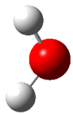
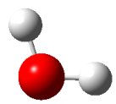
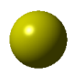
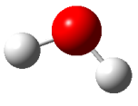
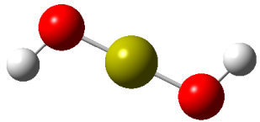
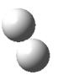
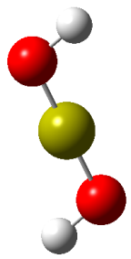
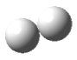
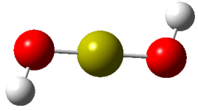

Depicted to the right is the reaction of calcium with water to form calcium hydroxide and hydrogen. If one mole of calcium is reacted with one mole of water, how many moles of calcium hydroxide will be formed?
a) 0.25 moles
d) 1.0 moles
b) 0.33 moles
e) 1.5 moles
c) 0.50 moles
© 2014 Pearson Education, Inc.
Notes:
Answer: c

Slide 17
Depicted to the right is the reaction of calcium with water to form calcium hydroxide and hydrogen. If one mole of calcium is reacted with one mole of water, how many moles of calcium hydroxide will be formed?
a) 0.25 moles
d) 1.0 moles
b) 0.33 moles
e) 1.5 moles
c) 0.50 moles
© 2014 Pearson Education, Inc.
Notes:
Answer: c

Slide 18
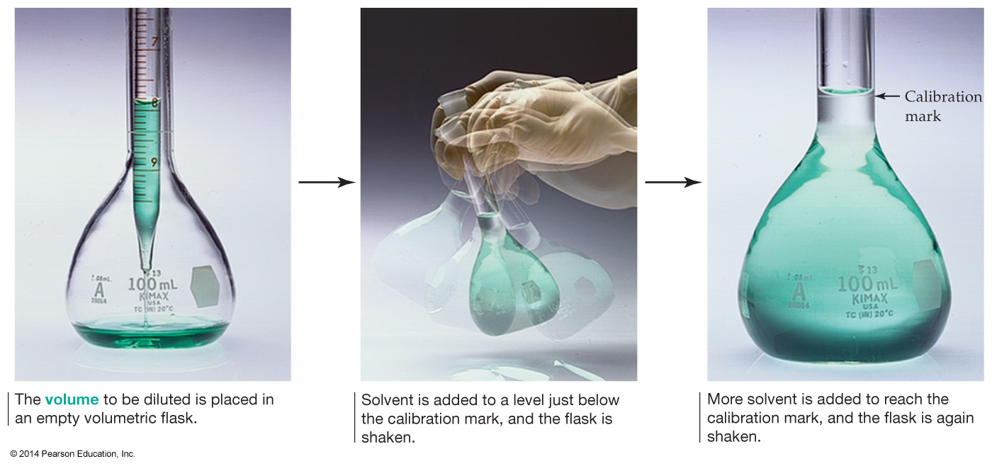
250.0 mL of 0.100 M HCl is required for a particular experiment. A 2.50 M stock solution is available. What volume of stock solution is needed to prepare the required HCl solution?
a) 1.00 × 10^{–3} mL
d) 100 mL
b) 10.0 mL
e) 6250 mL
c) 12.5 mL
© 2014 Pearson Education, Inc.
Notes:
Answer: b

Slide 19
250.0 mL of 0.100 M HCl is required for a particular experiment. A 2.50 M stock solution is available. What volume of stock solution is needed to prepare the required HCl solution?
a) 1.00 × 10^{–3} mL
d) 100 mL
b) 10.0 mL
e) 6250 mL
c) 12.5 mL
© 2014 Pearson Education, Inc.
Notes:
Answer: b

Slide 20
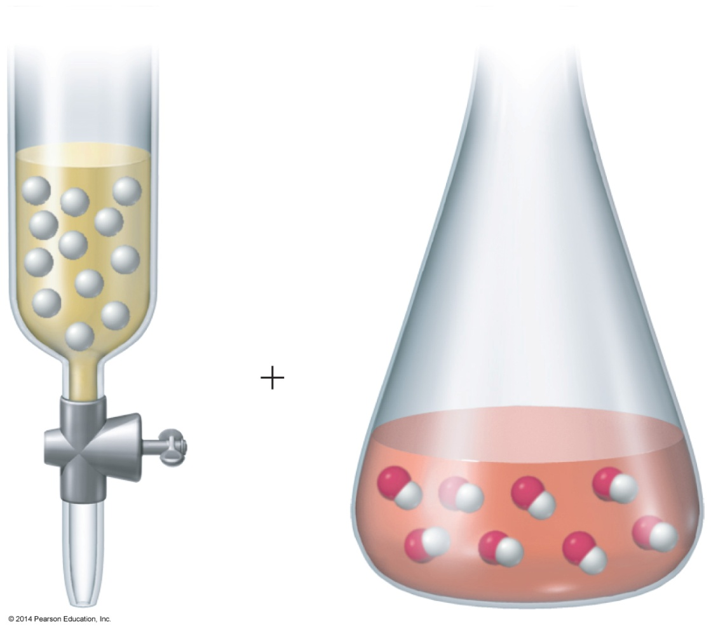
It was found that 10.0 mL of 0.100 M HCl was required to titrate a 20.0 mL aliquot of NaOH. What is the concentration of the sodium hydroxide solution?
a) 0.0500 M
b) 0.100 M
c) 0.150 M
d) 0.200 M
e) 0.250 M
© 2014 Pearson Education, Inc.
Notes:
Answer: a

Slide 21
It was found that 10.0 mL of 0.100 M HCl was required to titrate a 20.0 mL aliquot of NaOH. What is the concentration of the sodium hydroxide solution?
a) 0.0500 M
b) 0.100 M
c) 0.150 M
d) 0.200 M
e) 0.250 M
© 2014 Pearson Education, Inc.
Notes:
Answer: a

Slide 22
A compound is found to consist of C, H, and O in abundances, by mass, of 40.0%, 6.7%, and 53.3%, respectively. A mass spectrum revealed that the compound’s molecular mass was 90.08 amu.
What is the molecular formula of the compound?
a) CH₂O
b) C₂H₄O₂
c) C₂H₂O₄
d) C₃H₆O₃
e) C₄H₁₀O₂
© 2014 Pearson Education, Inc.
Notes:
Answer: d

Slide 23
A compound is found to consist of C, H, and O in abundances, by mass, of 40.0%, 6.7%, and 53.3%, respectively. A mass spectrum revealed that the compound’s molecular mass was 90.08 amu.
What is the molecular formula of the compound?
a) CH₂O
b) C₂H₄O₂
c) C₂H₂O₄
d) C₃H₆O₃
e) C₄H₁₀O₂
© 2014 Pearson Education, Inc.
Notes:
Answer: d

Slide 24
When heated, potassium chlorate, KClO₃, acts as a source of oxygen in combustion reactions. It reacts with ordinary table sugar (C₁₂H₂₂O₁₁), violently producing potassium chloride, carbon dioxide, and water as shown in the unbalanced equation below.
What is the sum of the stoichiometric coefficients in the balanced equation?
a) 29
b) 33
c) 37
d) 40
e) 50
© 2014 Pearson Education, Inc.
Notes:
Answer: d

Slide 25
When heated, potassium chlorate, KClO₃, acts as a source of oxygen in combustion reactions. It reacts with ordinary table sugar (C₁₂H₂₂O₁₁), violently producing potassium chloride, carbon dioxide, and water as shown in the unbalanced equation below.
What is the sum of the stoichiometric coefficients in the balanced equation?
a) 29
b) 33
c) 37
d) 40
e) 50
© 2014 Pearson Education, Inc.
Notes:
Answer: d

Slide 26
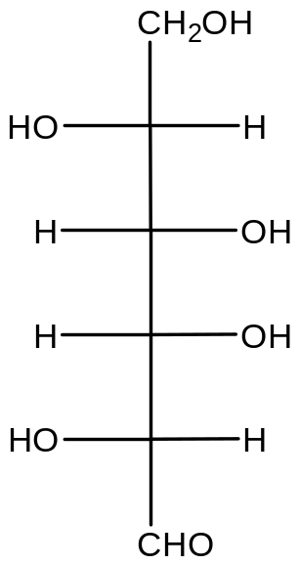
Glucose has the molecular formula C₆H₁₂O₆. Calculate the molar mass of fructose.
Input your answer as a number between 150 and 250 g mol^{–1}.
D-glucose
© 2014 Pearson Education, Inc.
Notes:
Answer: FW= 180.16 g mol^{–1}

Slide 27
Glucose has the molecular formula C₆H₁₂O₆. Calculate the molar mass of fructose.
Input your answer as a number between 150 and 250 g mol^{–1}.
FW= 180.16 g mol^{–1}
D-glucose
© 2014 Pearson Education, Inc.
Notes:
Answer: FW= 180.16 g mol^{–1}

Slide 28
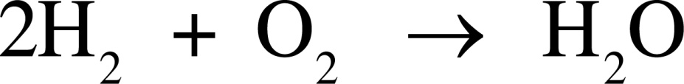
The space shuttle main engine burns liquid hydrogen and pure oxygen according to the following reaction.
What mass of O₂ is required to burn 26 g
of hydrogen?
a) 41 g
d) 52 g
b) 208 g
e) 13 g
c) 104 g
© 2014 Pearson Education, Inc.
Notes:
Answer: b

Slide 29
The space shuttle main engine burns liquid hydrogen and pure oxygen according to the following reaction.
What mass of O₂ is required to burn 26 g
of hydrogen?
a) 41 g
d) 52 g
b) 208 g
e) 13 g
c) 104 g
© 2014 Pearson Education, Inc.
Notes:
Answer: b

Slide 30
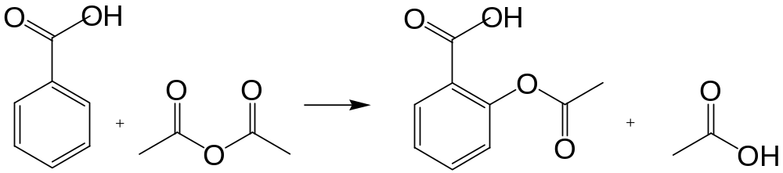
The following is a stick representation of the reaction of salicylic acid with acetic anhydride to produce acetylsalicylic acid (aspirin).
How many grams of acetic anhydride are required to react with 4.50 g of salicylic acid? Work in groups.
a) 3.32 g
c) 6.64 g
e) None of the above
b) 6.09 g
d) 13.28 g
© 2014 Pearson Education, Inc.
Notes:
Answer: a

Slide 31
The following is a stick representation of the reaction of salicylic acid with acetic anhydride to produce acetylsalicylic acid (aspirin).
How many grams of acetic anhydride are required to react with 4.50 g of salicylic acid? Work in groups.
a) 3.32 g
c) 6.64 g
e) None of the above
b) 6.09 g
d) 13.28 g
© 2014 Pearson Education, Inc.
Notes:
Answer: a

Slide 32
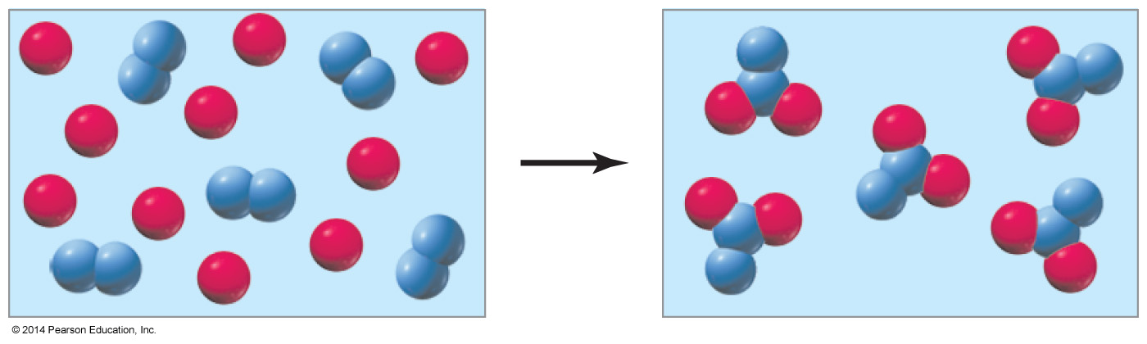




The reaction of A (red spheres) with B (blue spheres) is shown in the following diagram:
The stoichiometry of the reaction is best represented by which of the following?
a)
b)
c)
d)
e) None of the above
© 2014 Pearson Education, Inc.
Notes:
Answer: c

Slide 33
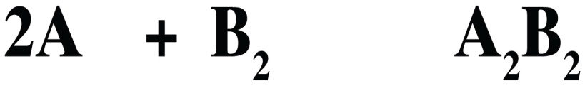
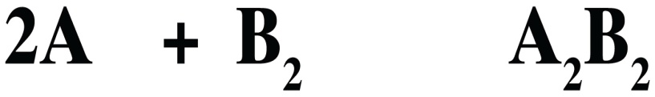
The reaction of A (red spheres) with B (blue spheres) is shown in the following diagram:
The stoichiometry of the reaction is best represented by which of the following?
a)
b)
c)
d)
e) None of the above
© 2014 Pearson Education, Inc.
Notes:
Answer: c

Slide 34
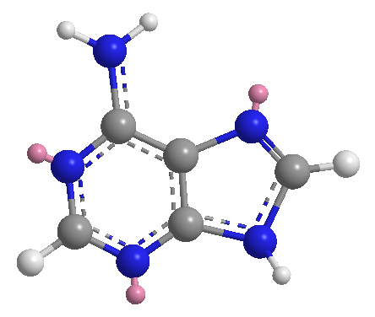
Adenine is a DNA base and is represented by the molecular model shown to the right.
If 0.020 mol of adenine were submitted to combustion analysis in the presence of a great excess of O₂, how
many moles of CO₂ would
be produced?
Adenine: C₅H₅N₅
molar mass = 135.1 g mol^{–1}
a) 0.020 mol
d) 0.10 mol
b) 0.060 mol
e) 0.12 mol
c) 0.080 mol
© 2014 Pearson Education, Inc.
Notes:
Answer: d

Slide 35
Adenine is a DNA base and is represented by the molecular model shown to the right.
If 0.020 mol of adenine were submitted to combustion analysis in the presence of a great excess of O₂, how
many moles of CO₂ would
be produced?
Adenine: C₅H₅N₅
molar mass = 135.1 g mol^{–1}
a) 0.020 mol
d) 0.10 mol
b) 0.060 mol
e) 0.12 mol
c) 0.080 mol
© 2014 Pearson Education, Inc.
Notes:
Answer: d

Slide 36
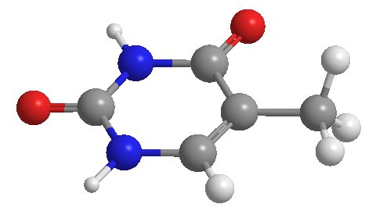
Thymine is a DNA base and is represented by the molecular model shown to the right. If 0.15 g of thymine were submitted to combustion analysis in the presence of a great excess of O₂, how many moles of H₂O would be produced?
Thymine: C₅H₆N₂O₂
molar mass = 126.1 g mol^{–1}
a) 0.0012 moles H₂O
d) 0.0071 moles H₂O
b) 0.0024 moles H₂O
e) 0.014 moles H₂O
c) 0.0036 moles H₂O
© 2014 Pearson Education, Inc.
Notes:
Answer: c

Slide 37
Thymine is a DNA base and is represented by the molecular model shown to the right. If 0.15 g of thymine were submitted to combustion analysis in the presence of a great excess of O₂, how many moles of H₂O would be produced?
Thymine: C₅H₆N₂O₂
molar mass = 126.1 g mol^{–1}
a) 0.0012 moles H₂O
d) 0.0071 moles H₂O
b) 0.0024 moles H₂O
e) 0.014 moles H₂O
c) 0.0036 moles H₂O
© 2014 Pearson Education, Inc.
Notes:
Answer: c

Slide 38
Consider what would happen if one mole of pennies were distributed equally among Earth’s population. Calculate the amount of money each person would have and how long it would take to spend it at
1 million dollars per day.
How many years would it take each person to spend the money?
a. < 100 years
d. 2001–4000 years
b. 100–1000 years
e. > 4000 years
c. 1001–2000 years
© 2014 Pearson Education, Inc.
Notes:
Answer: d

Slide 39
Consider what would happen if one mole of pennies were distributed equally among Earth’s population. Calculate the amount of money each person would have and how long it would take to spend it at
1 million dollars per day.
How many years would it take each person to spend the money?
a. < 100 years
d. 2001–4000 years
b. 100–1000 years
e. > 4000 years
c. 1001–2000 years
© 2014 Pearson Education, Inc.
Notes:
Answer: d

